Slide 1
OFFICE APPLICATION
PROCESSING WORD

Slide 2
Objectives
To describe different Word Processors
To explain different types of toolbars

Slide 3
Types of Word Processors
Word processors are software applications designed for creating, editing, formatting, and printing text-based documents.
They vary in features, complexity, and usage environments.

Slide 4
Stand-alone / Desktop Word Processors
These are full-featured applications installed on a computer.
They work offline but can also connect to cloud storage.
Examples & Features:
Microsoft Word – Industry-standard with rich formatting, templates, mail merge, and collaboration.
LibreOffice Writer – Free and open-source alternative with most MS Word capabilities.
WPS Office Writer – Lightweight, MS Word–compatible, with built-in PDF tools.
Corel WordPerfect – Popular in legal and publishing industries; strong formatting control.

Slide 5
2. Online / Cloud-based Word Processors
Run directly in a web browser; documents are stored online and accessible from any device.
They often support real-time collaboration.
Examples & Features:
Google Docs – Free, real-time collaboration, automatic cloud saving.
Zoho Writer – Clean interface, supports multiple export formats, integrates with Zoho tools.
OnlyOffice Docs – Compatible with MS Office formats, team collaboration features.
Microsoft Word Online – Browser version of MS Word with basic editing tools.

Slide 6
3. Mobile Word Processors
Designed for smartphones and tablets, often with touch-friendly interfaces.
Examples & Features:
Microsoft Word (Mobile) – Syncs with OneDrive, supports editing and reviewing on the go.
Google Docs (Mobile) – Lightweight, collaborative editing from mobile devices.
WPS Office (Mobile) – Combines word processing, spreadsheets, and presentations in one app.

Slide 7
4. Specialized / Niche Word Processors
Focused on specific writing needs such as books, scripts, or academic work.
Examples & Features:
Scrivener – Ideal for novelists, screenwriters, and researchers; organizes large projects.
LaTeX (via editors like TeXworks or Overleaf) – Used for technical, academic, and scientific papers with complex formatting like equations.
Final Draft – Professional screenwriting tool with automatic script formatting.
AbiWord – Lightweight, open-source for low-resource computers.

Slide 8
Types of toolbars
A toolbar is a bar in a computer program that contains tools in the form of icons, buttons, or menus.
Each tool performs a particular task, such as formatting text, inserting pictures, or saving a document.
In modern applications like Microsoft Office, toolbars are often organized into groups inside the Ribbon, and each group contains related tools.

Slide 9
Types of Toolbars in Microsoft Word
Quick Access Toolbar
Located at the top-left corner of the Word window. Contains frequently used commands like Save, Undo, Redo, Print. You can customize it by adding your favorite commands.
Ribbon
The main toolbar area in modern Word versions. Divided into Tabs like Home, Insert, Design, Layout, References, Review, View. Each tab has Groups with related tools (e.g., the Home tab has Font, Paragraph, Styles).

Slide 10
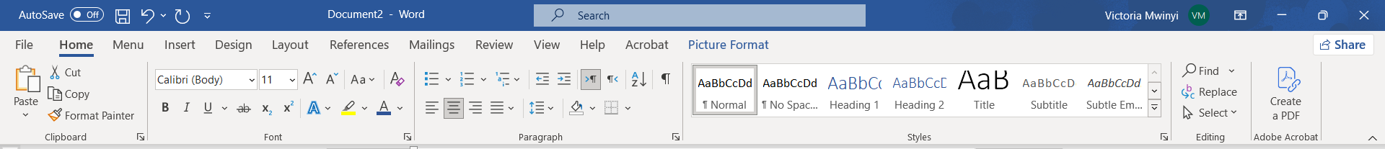
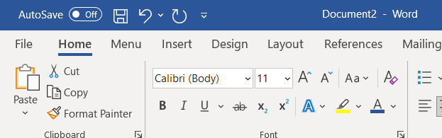
Ribbon
Contextual Toolbars / Tabs

Slide 11
Types of Toolbars in Microsoft Word
Status Bar
Located at the bottom of the Word window.
Shows information like Page Number, Word Count, Language, and sometimes shortcuts for View options.
Not technically a toolbar for commands, but it gives quick info and some interactive tools.
Contextual Toolbars / Tabs
Appear only when certain objects are selected (e.g., images, tables, charts).
Example: Selecting an image opens the Picture Format tab with tools for editing the image.

Slide 12
